Slide 1

Introduction to Machine Learning Topic 4 – Classification (HOML Ch. 3 / ISL Ch. 4 )
Master in Quantitative Economic Analysis MQuEA
Javier Bas
Universidad Autónoma de Madrid
2022/2023

Slide 2
Outline
Classifying?
Classifiers
Logistic Regression
Linear discriminant analysis (LDA)
Stochastic Gradient Descent (SGD)
Support Vector Machines (SVM)
K-Nearest Neighbors (KNN)
Performance measures
Training a binary classifier
Multiclass (multinomial) classification
This is actually an optimization method!
Master in Quantitative Economic Analysis MQuEA
Universidad Autónoma de Madrid

Slide 3
Classifying?
Our example from Topic 2 was a regression problem: estimating the value of a quantitative variable
However, in many situations, the response is qualitative (also named categorical). The observations have a label assigned, i.e, the category they pertain to
A person arriving at the emergency room has symptoms that can be attributed to three different medical conditions
A bank needs to determine if a transaction is fraudulent or not on the basis of historical transaction history, IP address, and other information
Based on socioeconomic information, we would like to determine whether a person is an Electric Vehicle Adopter or not
Image analysis to determine whether a Tumor is cancer
Master in Quantitative Economic Analysis MQuEA
Universidad Autónoma de Madrid

Slide 4
Classifying?
The problem becomes assigning each observation to a category, this is classifying them into the correct label
This involves to calculate probabilities (of belonging to each category) as the basis of making the classification.
There are many classification algorithms
Logistic regression
Linear discriminant analysis
Support Vector Machines
K-nearest neighbors
Master in Quantitative Economic Analysis MQuEA
Universidad Autónoma de Madrid

Slide 5
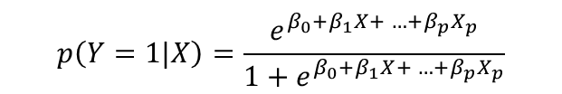
Classifiers – Logistic regression
Rather than modeling the response variable Y, a logistic regression measures the probability that Y belongs to a particular category
$$p\left(Y=1|X\right)=\frac{e^{β_{0}+β_{1}X+ …+β_{p}X_{p}}}{1+e^{β_{0}+β_{1}X+ …+β_{p}X_{p}}}$$
$$p\left(Y=1|X\right)=β_{0}+β_{1}X+ …+β_{p}X_{p}$$
Master in Quantitative Economic Analysis MQuEA
Universidad Autónoma de Madrid

Slide 6
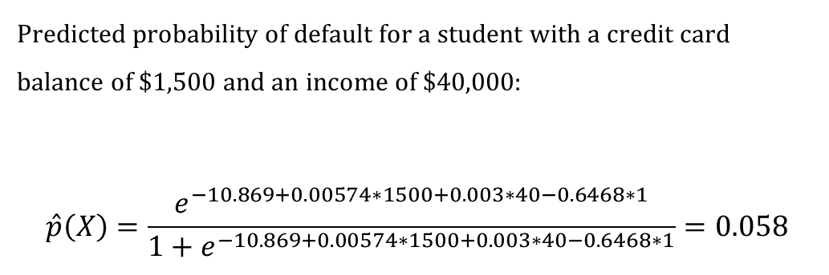
Classifiers – Logistic regression
The estimation of the coefficients is performed by maximum likelihood, this is a method that seeks for estimates of βs such that the predicted probability corresponds as closely as possible to the observed label. This is, when those βs are plugged in the regression, they reproduce the sample labels as much as possible.
Logistic regression provides coefficients, standard deviations, p-values, and odds ratios.
 | Coefficient | Std. Error | z-statistic | p-value
Intercept | -10.8690 | 0.4923 | -22.08 | <0.0001
Balance | 0.0057 | 0.0002 | 24.74 | <0.0001
Income | 0.0030 | 0.0082 | 0.37 | 0.7115
Student[Yes] | -0.6468 | 0.2362 | -2.47 | 0.0062
Predicted probability of default for a student with a credit card balance of $1,500 and an income of $40,000:
$$\hat{p}\left(X\right)=\frac{e^{−10.869+0.00574∗1500+0.003∗40−0.6468∗1}}{1+e^{−10.869+0.00574∗1500+0.003∗40−0.6468∗1}}=0.058$$
Master in Quantitative Economic Analysis MQuEA
Universidad Autónoma de Madrid

Slide 7
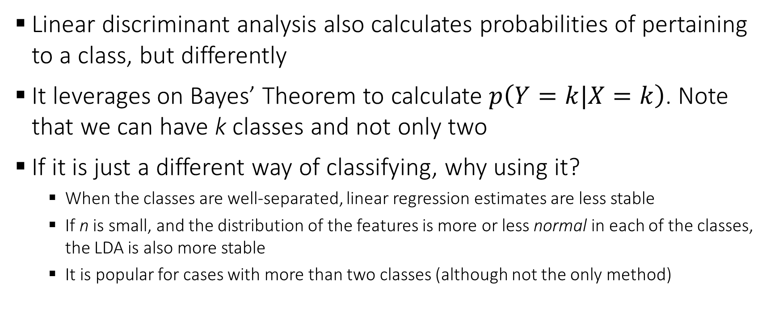
Classifiers – Linear discriminant analysis (LDA)
Linear discriminant analysis also calculates probabilities of pertaining to a class, but differently
It leverages on Bayes’ Theorem to calculate $p\left(Y=k|X=k\right)$. Note that we can have k classes and not only two
If it is just a different way of classifying, why using it?
When the classes are well-separated, linear regression estimates are less stable
If n is small, and the distribution of the features is more or less normal in each of the classes, the LDA is also more stable
It is popular for cases with more than two classes (although not the only method)
Master in Quantitative Economic Analysis MQuEA
Universidad Autónoma de Madrid

Slide 8

Classifiers – Support Vector Machines (SVM)
Support Vector Classifier (SVC) is a type of model able to perform linear and nonlinear classification
It behaves well in classification tasks in small to medium size datasets
It is relatively easy to find a separating hyperplane that separates the space, so it classifies very accurately the observations.
A test observation is assigned to a class depending on which side of the hyperplane falls in.
$β_{0}+β_{1}x_{i1}$ $+β_{2}x_{i2}$+…+ $+β_{p}x_{ip}>0 if y_{i}=1$
$β_{0}+β_{1}x_{i1}$ $+β_{2}x_{i2}$+…+ $+β_{p}x_{ip}<0 if y_{i}=−1$
Master in Quantitative Economic Analysis MQuEA
Universidad Autónoma de Madrid

Slide 9
Classifiers – Support Vector Machines (SVM)
What if sets are not completely separable? Soft margins or kernels
A non-linear boundary would actually fit better
Support vectors
Maximal margin hyperplane
Hard margin
Soft margin
Master in Quantitative Economic Analysis MQuEA
Universidad Autónoma de Madrid

Slide 10
Classifiers – Support Vector Machines (SVM)
The Support Vector Machine is an extension of the Support Vector Classifier, it allows to enlarger the feature space in a specific way using kernels. In other words, look for boundaries o different shapes.
Here is the scikit-learn documentation about SVM: https://scikit-learn.org/stable/modules/generated/sklearn.svm.SVC.html?highlight=svc#sklearn.svm.SVC
Polynomial kernel (degree 3)
Radial kernel
Master in Quantitative Economic Analysis MQuEA
Universidad Autónoma de Madrid

Slide 11
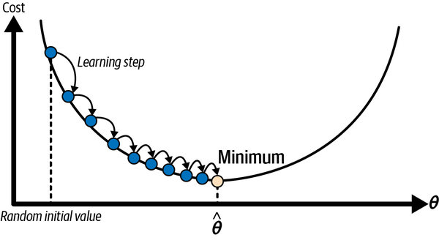
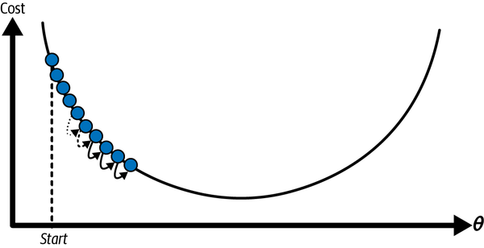
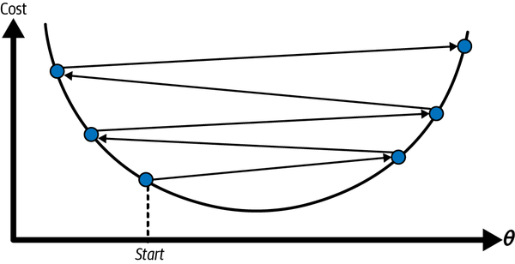
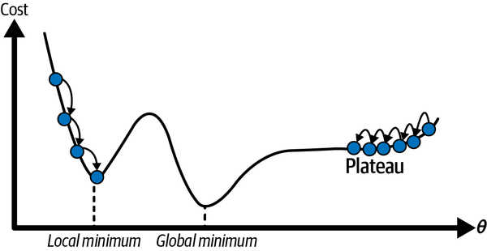
Classifiers – Stochastic Gradient Descent (SGD)
Gradient descent is a method to find the minimum of a function (loss function in our case). In each iteration, the algorithm descents the slope of the function in a “little step”
Get the slope of the “mountain” in all directions (gradient)
Go in the opposite direction to go “downhill”
Adapt the “size” of your step
Master in Quantitative Economic Analysis MQuEA
Universidad Autónoma de Madrid

Slide 12
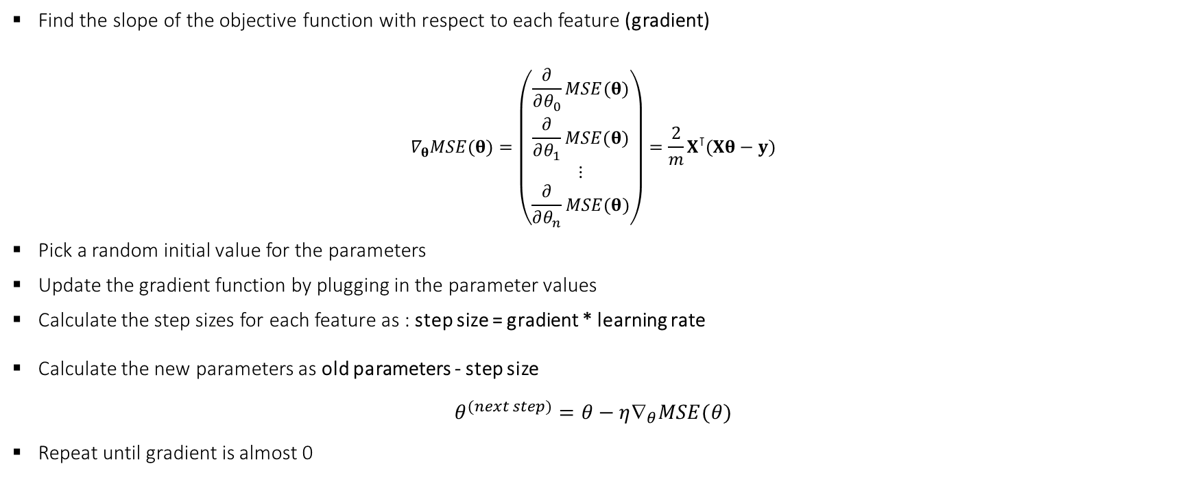
Classifiers – Stochastic Gradient Descent (SGD)
Find the slope of the objective function with respect to each feature (gradient)
$$∇_{θ}MSE(θ)=\left(\begin{aligned}\frac{∂}{∂θ_{0}}MSE(θ) \\ \frac{∂}{∂θ_{1}}MSE(θ) \\ ⋮ \\ \frac{∂}{∂θ_{n}}MSE(θ)\end{aligned}\right)=\frac{2}{m}X^{⊺}(Xθ−y)$$
Pick a random initial value for the parameters
Update the gradient function by plugging in the parameter values
Calculate the step sizes for each feature as : step size = gradient * learning rate
Calculate the new parameters as old parameters - step size
$$θ^{(next step)}=θ−η{\text{∇}}_{θ}MSE(θ)$$
Repeat until gradient is almost 0
This is a hyperparameter!!
Master in Quantitative Economic Analysis MQuEA
Universidad Autónoma de Madrid

Slide 13
Classifiers – Stochastic Gradient Descent (SGD)
This process involves a large number of calculations. For example: 10,000 observations x 10 features x 1,000 iterations (a usual number) = 100,000,000 computations for an estimation
Stochastic (random) Gradient Descent applies the same algorithm to one only observation picked up randomly (a predefined number of times)
It can not get to the local minimum, but works very well when the loss function is irregular
Solution is to use a learning rate schedule
Mini-batch Gradient Descent offers a compromise between GD and SGD by splitting the data into smaller batches.
The point is that a SGDClassifier is equivalent to a linear SVM (Here is the scikit-learn documentation about SGD: https://scikit-learn.org/stable/modules/sgd.html)
Master in Quantitative Economic Analysis MQuEA
Universidad Autónoma de Madrid

Slide 14
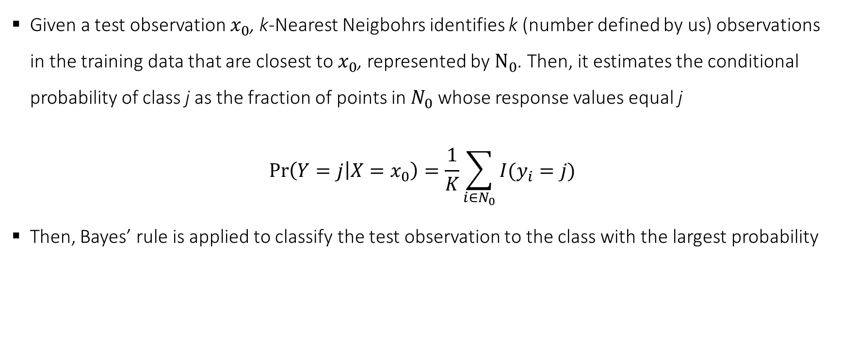
Classifiers – k-Nearest Neighbors (k-NN)
Given a test observation $x_{0}$, k-Nearest Neigbohrs identifies k (number defined by us) observations in the training data that are closest to $x_{0}$, represented by $N_{0}$. Then, it estimates the conditional probability of class j as the fraction of points in $N_{0}$ whose response values equal j
$$\operatorname{Pr}\left(Y=j | X=x_{0}\right)=\frac{1}{K}\sum_{i∈N_{0}}{I(y_{i}=j)}$$
Then, Bayes’ rule is applied to classify the test observation to the class with the largest probability
The “I” is just indicating if the parenthesis is happening
Master in Quantitative Economic Analysis MQuEA
Universidad Autónoma de Madrid

Slide 15
Classifiers – k-Nearest Neighbors (k-NN)
Master in Quantitative Economic Analysis MQuEA
Universidad Autónoma de Madrid

Slide 16
Classifiers – k-Nearest Neighbors (k-NN)
The choice of K is very relevant. In this example K = 1 is too flexible and finds non-existent patterns. As K grows, the method becomes less and less flexible, until becoming an almost straight line.
Training: The more flexible (K decreases), the less error
Testing: Decreasing K is OK but at some point, it increases again (excessively flexible so it overfits!!)
Master in Quantitative Economic Analysis MQuEA
Universidad Autónoma de Madrid

Slide 17
Performance measures
To evaluate a regression, one only needs to pay attention to the performance measure (the lower, the better). But assessing performance in a classification is bit more nuance.
Just looking for a better accuracy (% of correct predictions) is not enough…
Imagine a task consisting in classifying patients into COVID infected or not. The algorithm will perform well if
Classifies as infected individuals that do have the disease
Classifies as not infected individuals that do not have the disease.
Do not classify as infected a person that is totally healthy
Do not classify as not infected a person that is actually sick
Master in Quantitative Economic Analysis MQuEA
Universidad Autónoma de Madrid

Slide 18
Performance measures
To evaluate a regression, one only needs to pay attention to the performance measure (the lower, the better). But assessing performance in a classification is bit more nuance.
Just looking for a better accuracy (% of correct predictions) is not enough…
Imagine a task consisting in classifying patients into COVID-19 infected or not. The algorithm will perform well if:
Maximizes the number of individuals classified as infected when they are so (True Positive)
Maximizes the number of individuals classified as not infected when they do not have the disease. (True Negative)
Minimizes the number of individuals classified as infected when they are (False Positive)
Minimizes the number of individuals classify as not infected when they are actually sick (False Negative)
Master in Quantitative Economic Analysis MQuEA
Universidad Autónoma de Madrid

Slide 19
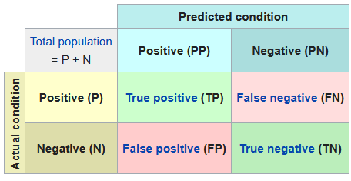

Performance measures
That information, organize in the following way, is called Confusion Matrix
Several interesting calculations emerge from it, yielding a much richer information than just accuracy
$$Precision= \frac{TP}{TP+FP}$$
$$Recall=\frac{TP}{TP+FN}$$
$$Specificity=\frac{TN}{TN+FP}$$
Sensitivity, hit rate, true positive rate…
Selectivity, true negative rate…
Source: Wikipedia (https://en.wikipedia.org/wiki/Confusion_matrix)
Master in Quantitative Economic Analysis MQuEA
Universidad Autónoma de Madrid

Slide 20

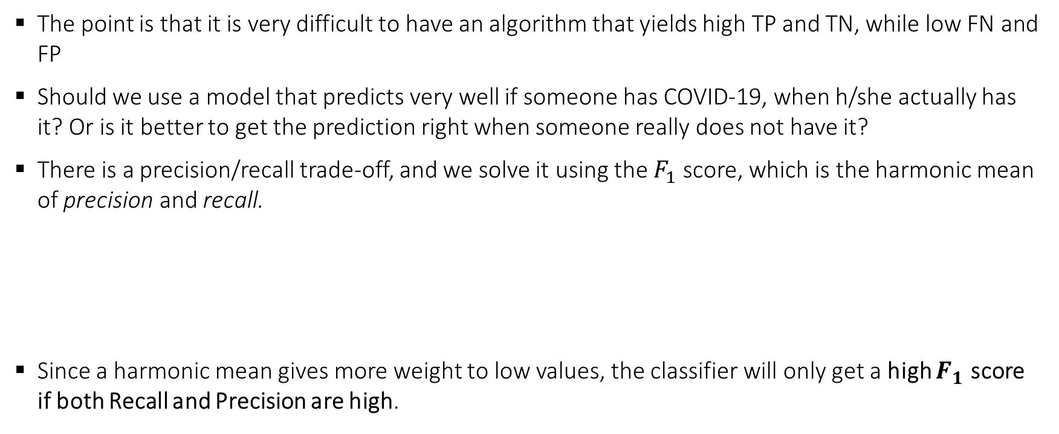
Performance measures
The point is that it is very difficult to have an algorithm that yields high TP and TN, while low FN and FP
Should we use a model that predicts very well if someone has COVID-19, when h/she actually has it? Or is it better to get the prediction right when someone really does not have it?
There is a precision/recall trade-off, and we solve it using the $F_{1}$score, which is the harmonic mean of precision and recall.
Since a harmonic mean gives more weight to low values, the classifier will only get a high $F_{1}$ score if both Recall and Precision are high.
$$F_{1}= \frac{TP}{TP+\frac{FN+FP}{2}}$$
Master in Quantitative Economic Analysis MQuEA
Universidad Autónoma de Madrid

Slide 21
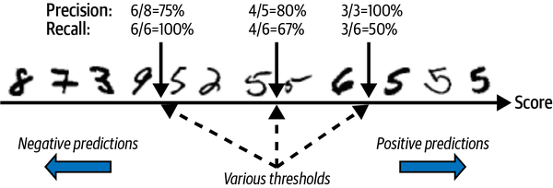
Performance measures
Now, classifiers assign labels based on a threshold. For each instance, it computes a score based on a decision function. If that score is greater than a threshold, it assigns the instance to the positive class; otherwise, it assigns it to the negative class
Therefore, if we modify the threshold, the classification will vary, achieving better or worse predictions, and yielding different Precision and Recall
Master in Quantitative Economic Analysis MQuEA
Universidad Autónoma de Madrid

Slide 22
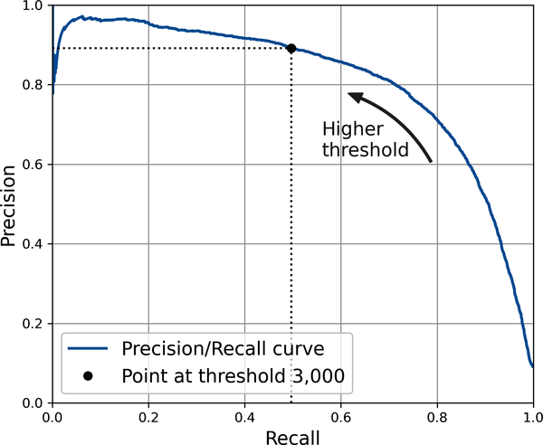
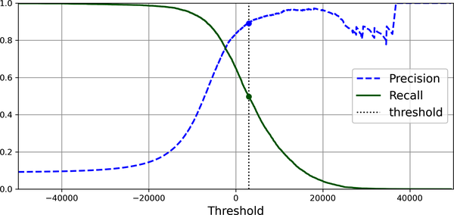
Performance measures
When Precision increases, Recall decreases, and vice versa
Master in Quantitative Economic Analysis MQuEA
Universidad Autónoma de Madrid

Slide 23
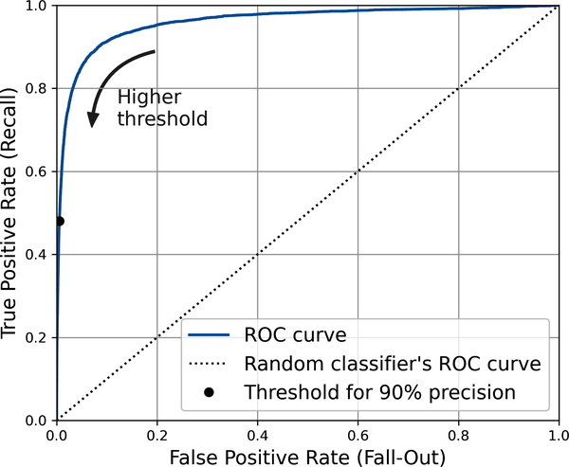
Performance measures
Instead of plotting Precision and Recall, it is common to plot the True Positive Rate (TPR) against the False Positive Rate (FPR), or, which the same, Sensitivity (Recall) versus 1 - Specificity
This plot is called the Receiver Operating Characteristic (ROC) curve
To compare two classifiers, we compute the area under the curve (AUC)
A perfect classifier would have an area of 1; so the higher, the better
Master in Quantitative Economic Analysis MQuEA
Universidad Autónoma de Madrid

Slide 24
Performance measures
Let’s jump into the notebook to see all of this in practice and estimating a couple of classifiers
Master in Quantitative Economic Analysis MQuEA
Universidad Autónoma de Madrid

